Slide 1

Time Series Analysis For Bitcoin Price Prediction Using Prophet

Slide 2
Contents of the presentation
Project Description
Problem Statement
Objective
Scope
Literature Survey
Significant
Proposed System
Architecture
UML
Resource Requirements
Research Gap analysis
Implementation
Implementation
1. Data Description
2. EDA Explanation
3. Preprocessing steps
Model Implementation
1. Algorithm Definition
2. working Process
3. Results from Algorithm
Performance comparison
Output Screen
Future Scope
Conclusion

Slide 3
Project Description
This study focuses on time series analysis for predicting Bitcoin prices using various methodologies, including Recurrent Neural Networks (RNN), Long Short-Term Memory networks (LSTM), Auto Regressive Integrated Moving Average (ARIMA), and Facebook's Prophet. We utilize a dataset consisting of timestamps and closing prices to train and evaluate the performance of these models. The objective is to identify the most effective forecasting technique for Bitcoin price movements, addressing the inherent volatility of cryptocurrency markets. By leveraging historical price data, we aim to enhance prediction accuracy, contributing to more informed trading decisions. Our findings will provide valuable insights into the applicability of different predictive models in the context of cryptocurrency, ultimately aiming to assist investors in navigating the complexities of Bitcoin trading. The results underscore the strengths and weaknesses of each method, paving the way for future research in financial time series analysis.
Keywords: RNN, LSTM, ARIMA and Prophet, Kaggle dataset.

Slide 4
Problem Statement
The cryptocurrency market, particularly Bitcoin, is characterized by high volatility, making accurate price prediction a significant challenge for investors. Traditional forecasting methods often struggle to adapt to the dynamic nature of these markets. This study aims to explore the effectiveness of various time series analysis techniques, including RNN, LSTM, ARIMA, and Facebook's Prophet, to predict Bitcoin prices. By employing a dataset of historical timestamps and closing prices, we seek to determine which methodology yields the most accurate forecasts, ultimately providing insights that can aid investors in making informed trading decisions amidst market fluctuations.

Slide 5
Objective of the Project
The primary objective of this project is to conduct a comprehensive time series analysis for predicting Bitcoin prices by comparing various forecasting methodologies, including RNN, LSTM, ARIMA, and Facebook's Prophet. We aim to utilize historical closing price data to develop and evaluate these models, with a focus on enhancing prediction accuracy amidst the inherent volatility of the cryptocurrency market. By identifying the most effective predictive technique, this study seeks to provide insights that will assist investors in making informed trading decisions, thereby contributing to a deeper understanding of financial time series analysis in the context of cryptocurrency.

Slide 6
Scope
This study explores the application of time series analysis techniques for predicting Bitcoin prices, focusing on RNN, LSTM, ARIMA, and Prophet models. By utilizing a comprehensive dataset of timestamps and closing prices, we aim to evaluate each model's performance in forecasting Bitcoin price movements amidst market volatility. The research will examine the strengths and weaknesses of these methodologies, offering insights into their effectiveness in cryptocurrency trading. Additionally, the findings will serve as a foundation for future studies in financial time series analysis, enabling investors to make data-driven decisions in an increasingly complex trading environment.

Slide 7
Literature Survey
S.NO | YEAR | AUTHORS | TITLE | OUT COMES
1 | 2022 | L. Serena, S. Ferretti, and G. D’Angelo. | Cryptocurrencies activity as a complex network: Analysis of transactions graphs. | The authors introduce the Distributed Ledger Network Analyzer (DiLeNA), a tool designed to investigate transaction networks. Their findings reveal that transaction graphs across all studied DLTs exhibit small-world properties, highlighting the importance of network analysis for understanding user interactions and the dynamics of cryptocurrency ecosystems.
2 | 2021 | B. Tao, I. W. Ho, and H.-N. Dai. | Complex network analysis of the Bitcoin blockchain network. | Using machine learning models like k-nearest neighbors, decision tree, and XGBoost, they achieve classification accuracies between 93.24% and 97.13%. Additionally, the study proposes a k-hop subgraph generation algorithm for in-depth network analysis and examines Bitcoin address behavior patterns, contributing to better understanding and tracking of blockchain transactions.

Slide 8
S.NO | YEAR | AUTHORS | TITLE | OUT COMES
3 | 2022 | B. Tao, H.-N. Dai, J. Wu, I. W. Ho, Z. Zheng, and C. F. Cheang | Complex network analysis of the Bitcoin transaction network | A novel subgraph generation algorithm, BTC-SubGen, extracts k-hop subgraphs from the Bitcoin transaction network. Classification using various machine learning models achieved accuracy rates between 93.24% and 97.13%. The study also explores feature importance and behavior patterns of Bitcoin addresses.
4 | 2021 | N. Tovanich, N. Soulié, N. Heulot, and P. Isenberg. | An empirical analysis of pool hopping behavior in the Bitcoin blockchain. | The study finds that while pool-hopping remains beneficial, the newer reward systems have improved fairness, reducing the disparity between pool-hoppers and static miners. Despite this, pool-hoppers still achieve a 33% higher median cumulative gain compared to static miners.

Slide 9
S.NO | YEAR | AUTHORS | TITLE | OUT COMES
5 | 2020 | I. Alqassem, I. Rahwan, and D. Svetinovic. | The anti-social system properties: Bitcoin network data analysis. | The Author Index details the primary entries for each item, organized by the first author’s name, and includes coauthors, paper titles, and publication specifics. The Subject Index categorizes entries by relevant subject headings, providing comprehensive bibliographic information. The focus of the paper is on analyzing Bitcoin’s network dynamics and its implications within an anti-social system framework.
6 | 2021 | P. Nerurkar, D. Patel, Y. Busnel, R. Ludinard, S. Kumari, and M. K. Khan. | Dissecting Bitcoin blockchain: Empirical analysis of Bit- coin network (2009–2020). | The study delves into the network’s local topology and geometry to understand how these social and antisocial characteristics influence Bitcoin's development. By analyzing transaction data from Bitcoin’s initial decade, the authors provide insights into the network's structural dynamics and how user behaviors shape its growth and challenges.

Slide 10
Significant
1. Diverse Methodologies: The study employs RNN, LSTM, ARIMA, and Prophet to forecast Bitcoin prices, highlighting the range of techniques available for time series analysis.
2. Volatility Focus: It addresses the challenges posed by the inherent volatility of cryptocurrency markets, which is crucial for accurate price prediction.
3. Dataset Utilization: The research utilizes a comprehensive dataset of timestamps and closing prices, ensuring robust model training and evaluation.
4. Prediction Accuracy: The primary objective is to enhance prediction accuracy, which can lead to more informed trading decisions for investors.
5. Insights for Future Research: Findings will provide insights into the strengths and weaknesses of each predictive model, contributing to ongoing advancements in financial time series analysis.

Slide 11
Proposed System
This study proposes a comprehensive system for predicting Bitcoin prices through time series analysis. By implementing various forecasting models—RNN, LSTM, ARIMA, and Facebook's Prophet—we will analyse historical price data to assess each model's effectiveness. The system will utilize a Kaggle dataset containing timestamps and closing prices, allowing us to train and evaluate the performance of the different methodologies. Our approach aims to enhance prediction accuracy amidst Bitcoin's volatility, offering insights into the strengths and limitations of each technique. Ultimately, the system seeks to aid investors in making informed trading decisions within the cryptocurrency market.

Slide 12
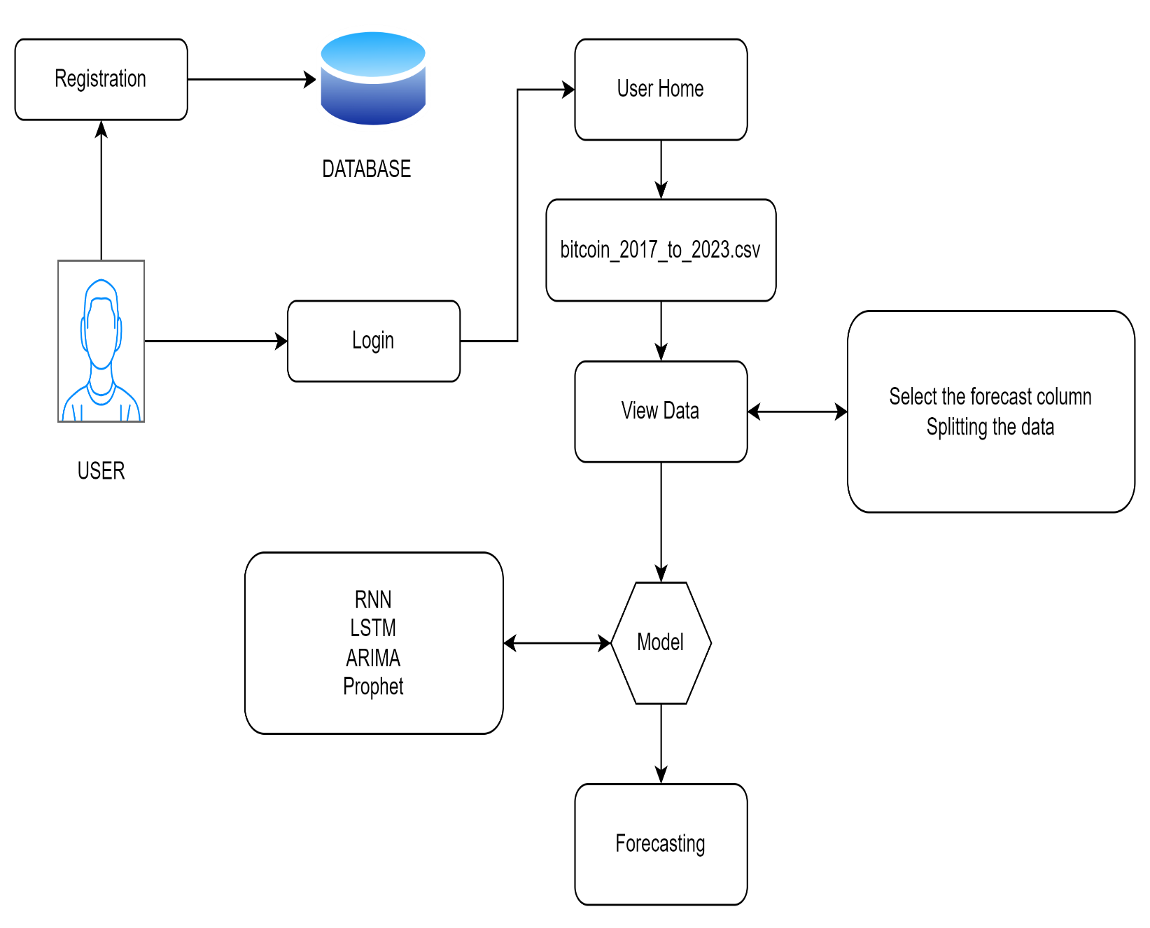
Architecture

Slide 13
Resource Requirements
01
Hardware
(Processor: I5/Intel Processor, RAM: 8GB (min), Hard Disk: 128 GB, Key Board: Standard Windows Keyboard, Mouse: Two or Three Button Mouse)
Resources
02
Software
(Operating System: Windows 10, Programming Language: Python 3.10.8, IDE: VS Code)
03
Packages/Libraries
(Streamlit, Sklearn, Transformers, Tensorflow, Pandas, Seaborn, Speech Recognition

Slide 14
Use Case Diagram:
1) A use case diagram in the Unified Modeling Language (UML) is a type of behavioral diagram defined by and created from a Use-case analysis.
2) Its purpose is to present a graphical overview of the functionality provided by a system in terms of actors, their goals (represented as use cases), and any dependencies between those use cases.
3) The main purpose of a use case diagram is to show what system functions are performed for which actor. Roles of the actors in the system can be depicted.

Slide 15
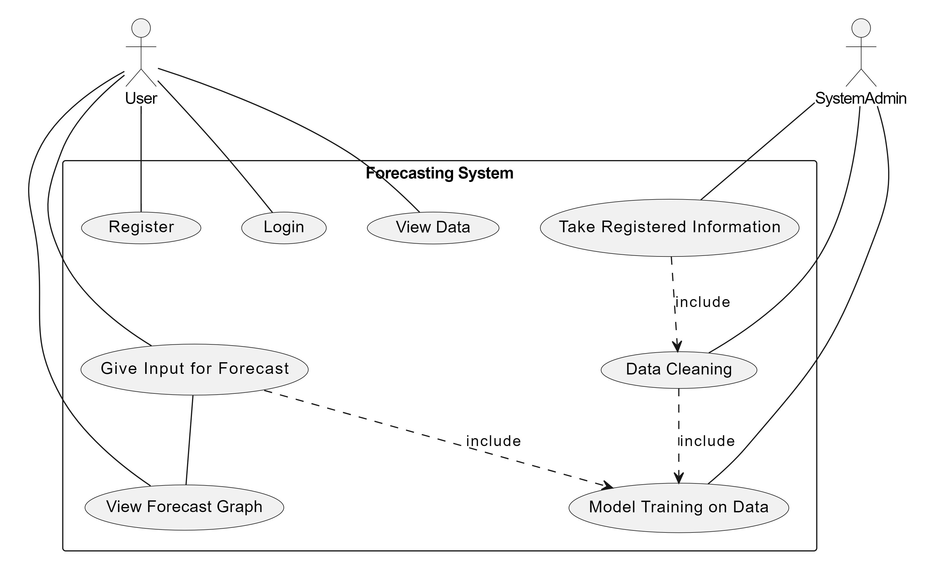
UML DIAGRAMS
Figure: Use Case Diagram

Slide 16
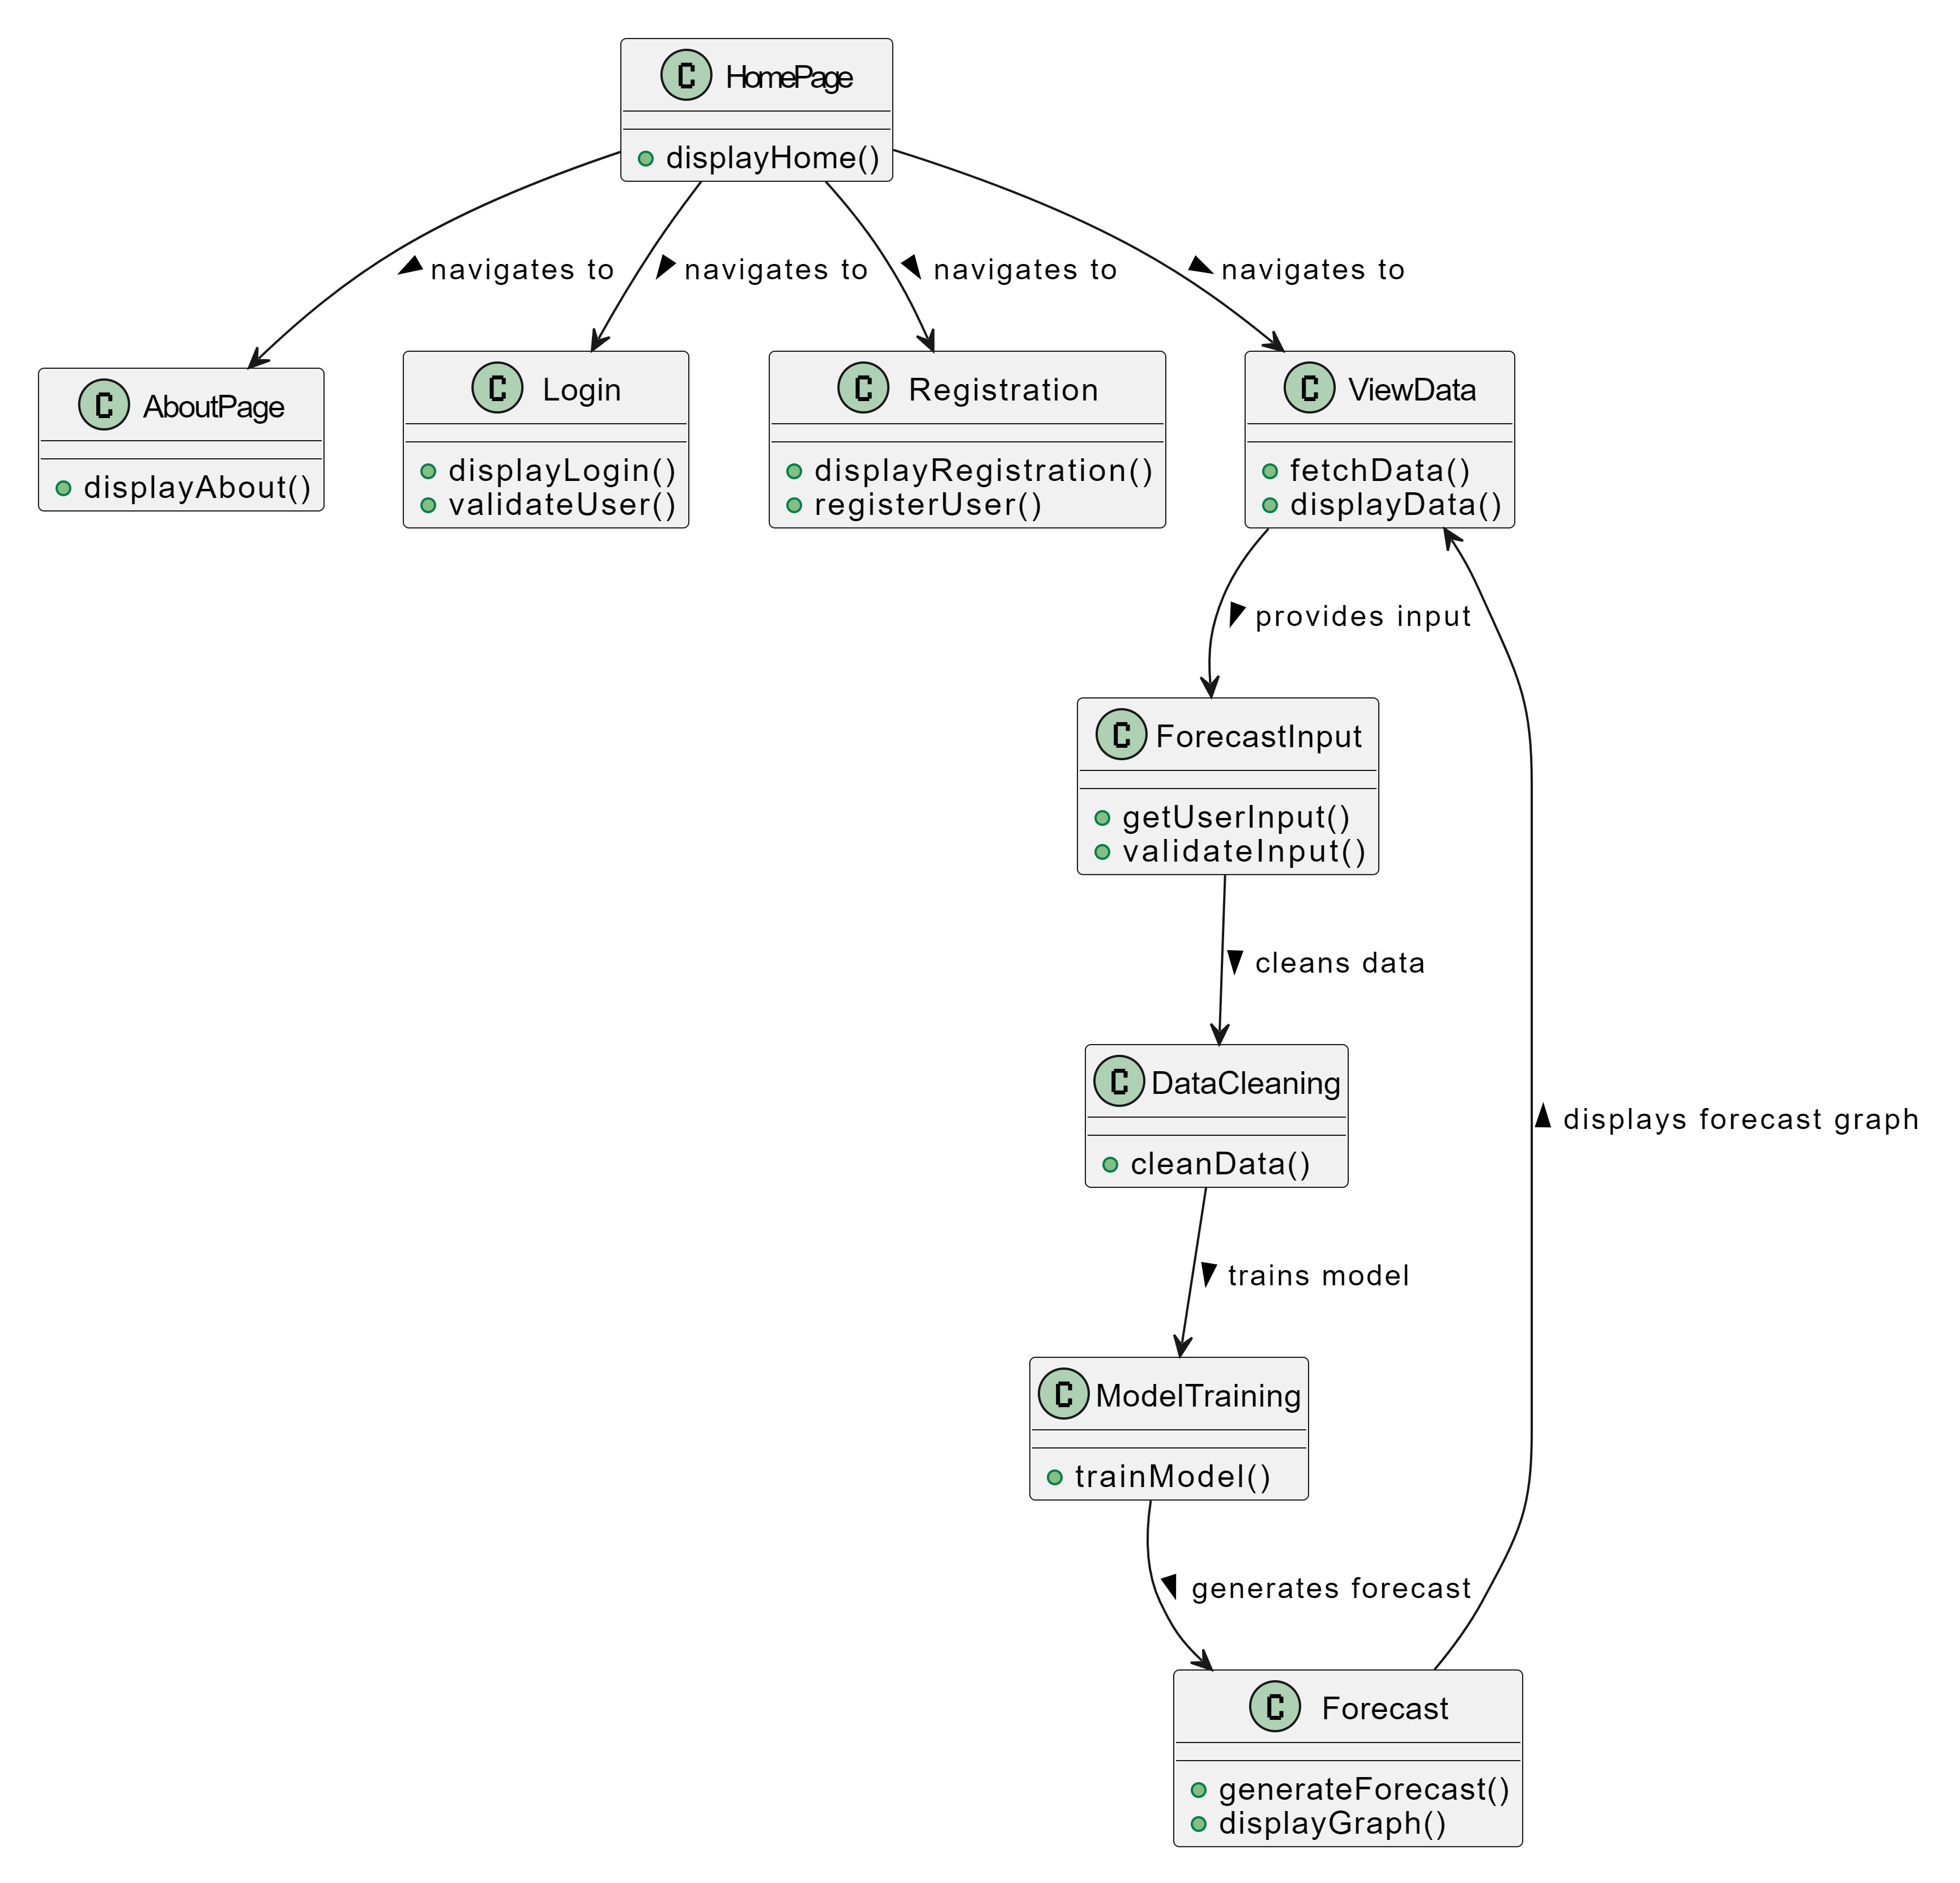
Class Diagram:
In software engineering, a class diagram in the Unified Modeling Language (UML) is a type of static structure diagram that describes the structure of a system by showing the system's classes, their attributes, operations (or methods), and the relationships among the classes. It explains which class contains information

Slide 17
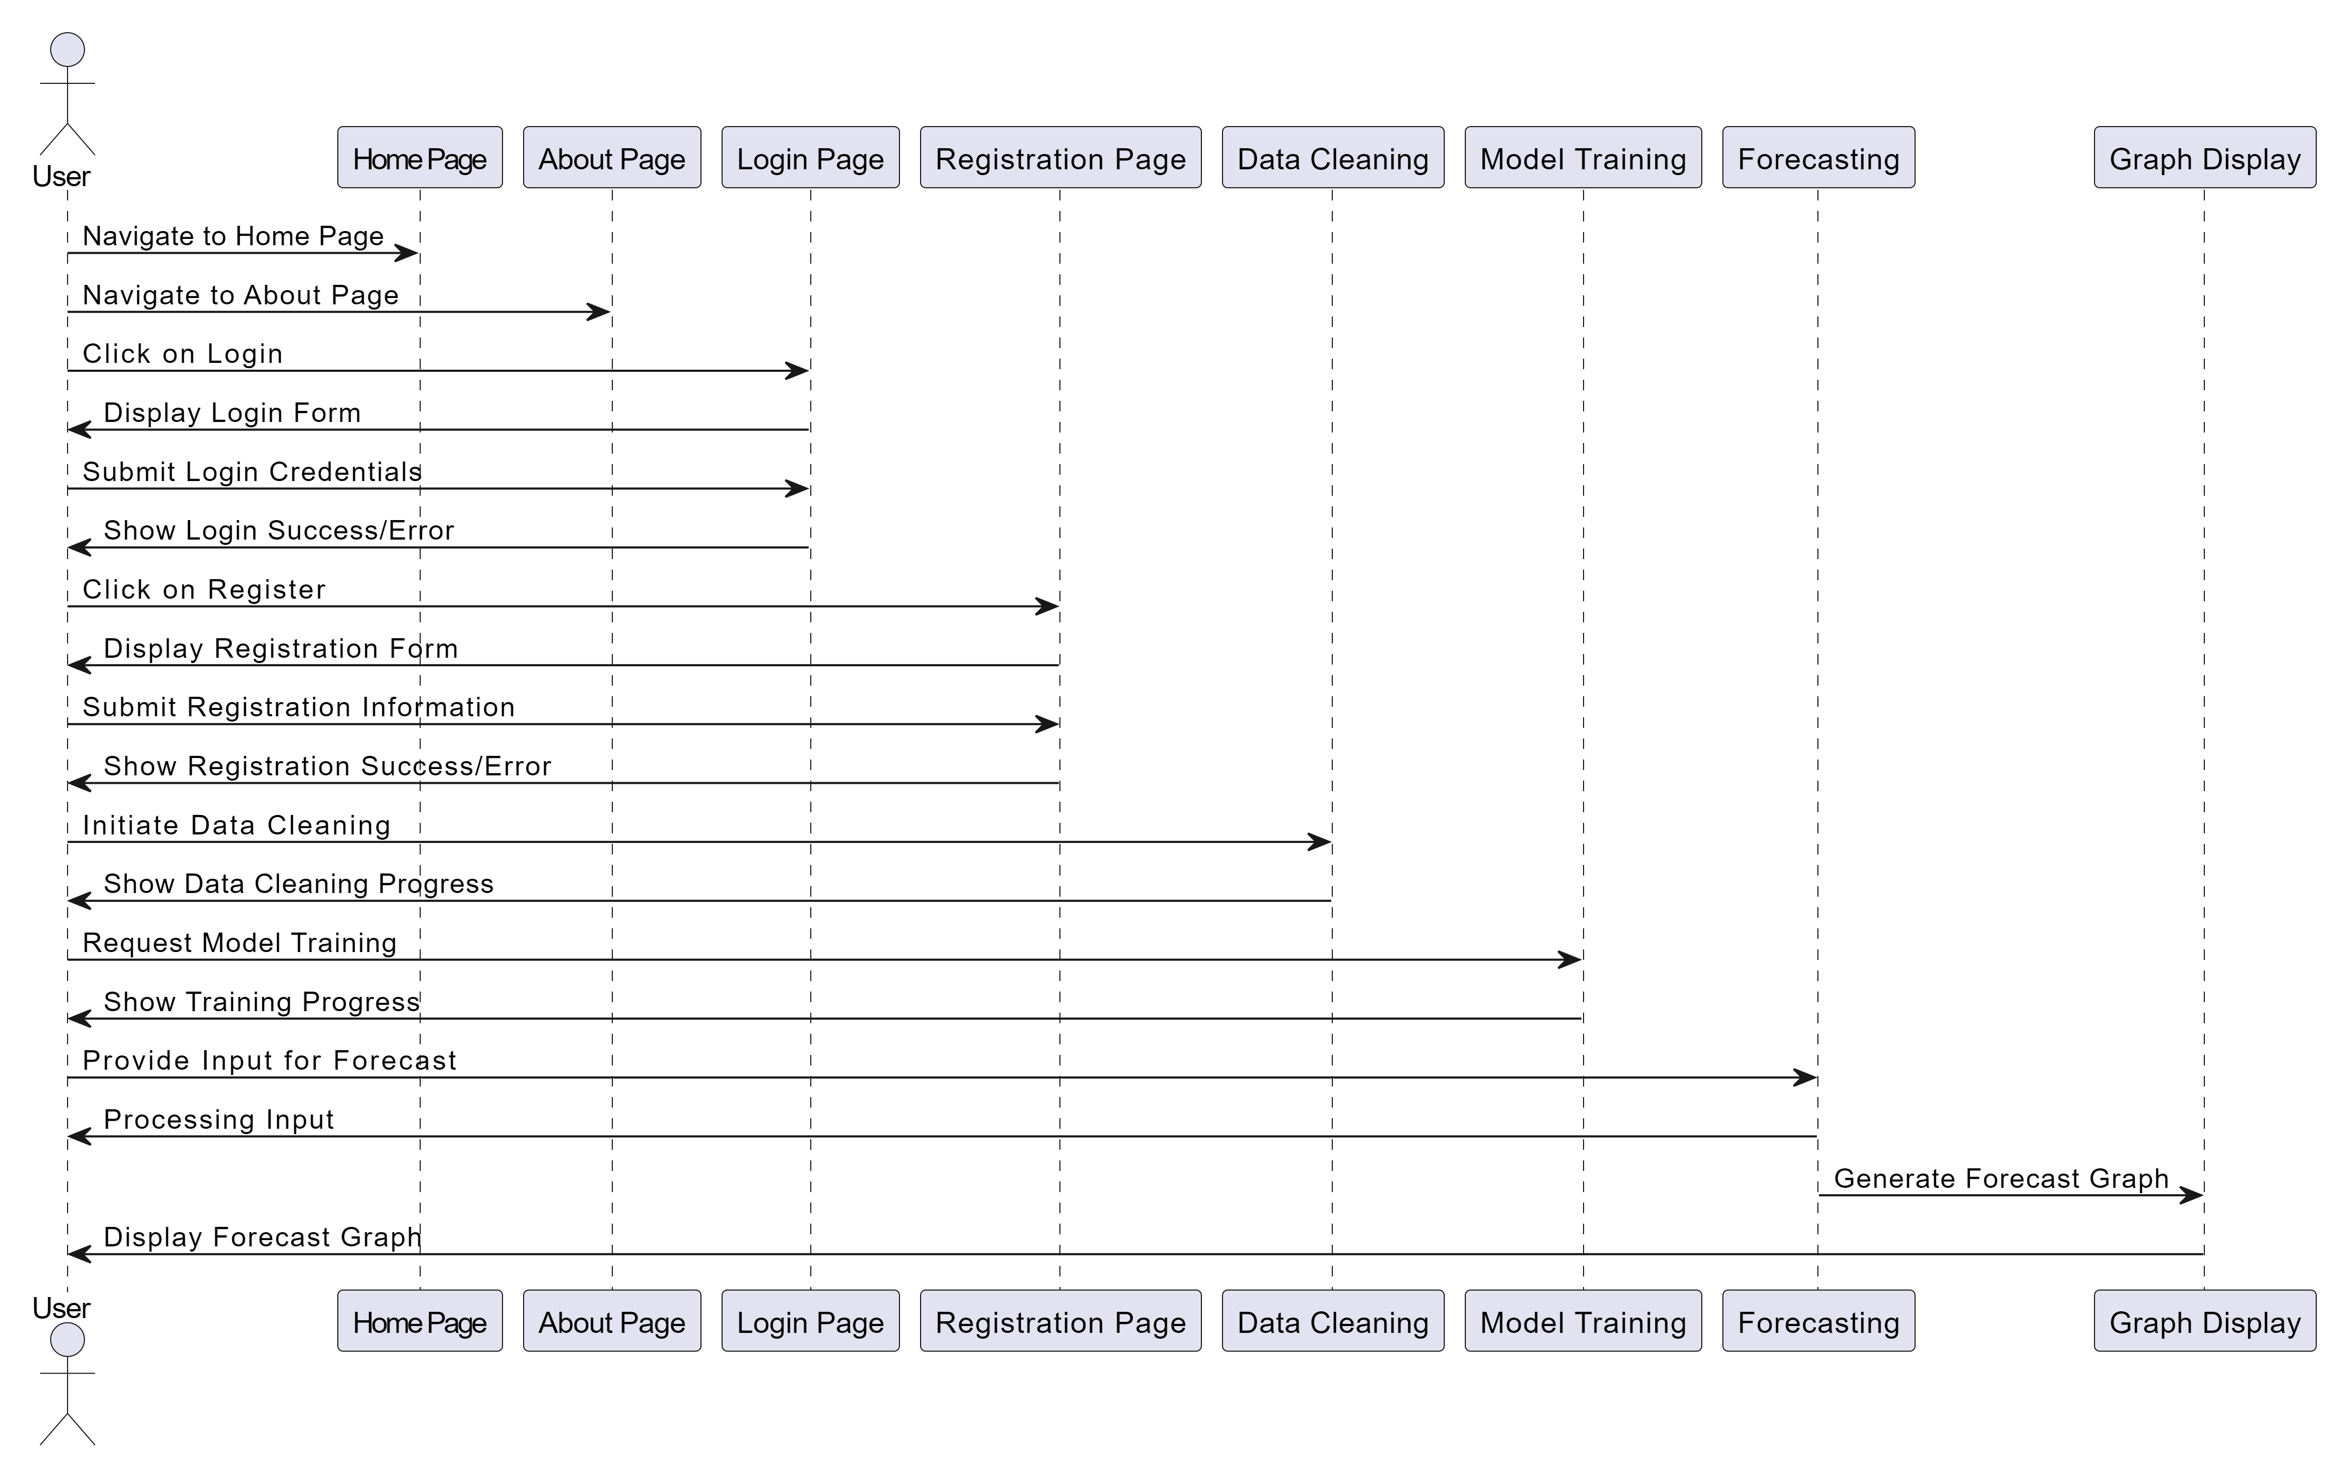
Sequence Diagram:
A sequence diagram in Unified Modeling Language (UML) is a kind of interaction diagram that shows how processes operate with one another and in what order.
It is a construct of a Message Sequence Chart. Sequence diagrams are sometimes called event diagrams, event scenarios, and timing diagrams
Figure: Sequence diagram

Slide 18
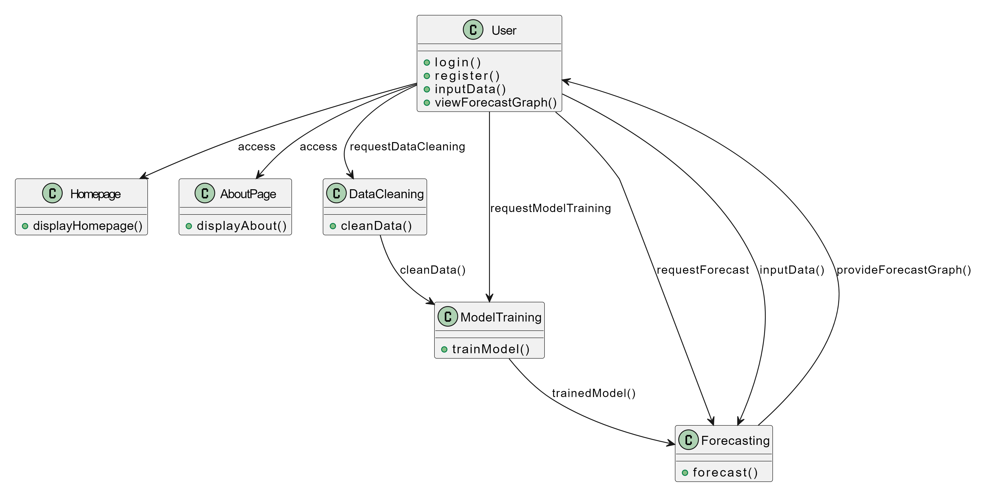
Collaboration Diagram:
In collaboration diagram the method call sequence is indicated by some numbering technique as shown below. The number indicates how the methods are called one after another. We have taken the same order management system to describe the collaboration diagram. The method calls are similar to that of a sequence diagram. But the difference is that the sequence diagram does not describe the object organization whereas the collaboration diagram shows the object organization.
Figure: Collaboration diagram

Slide 19
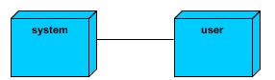
Deployment Diagram
Deployment diagram represents the deployment view of a system. It is related to the component diagram. Because the components are deployed using the deployment diagrams. A deployment diagram consists of nodes. Nodes are nothing but physical hardware’s used to deploy the application.
Figure: Deployment diagram

Slide 20
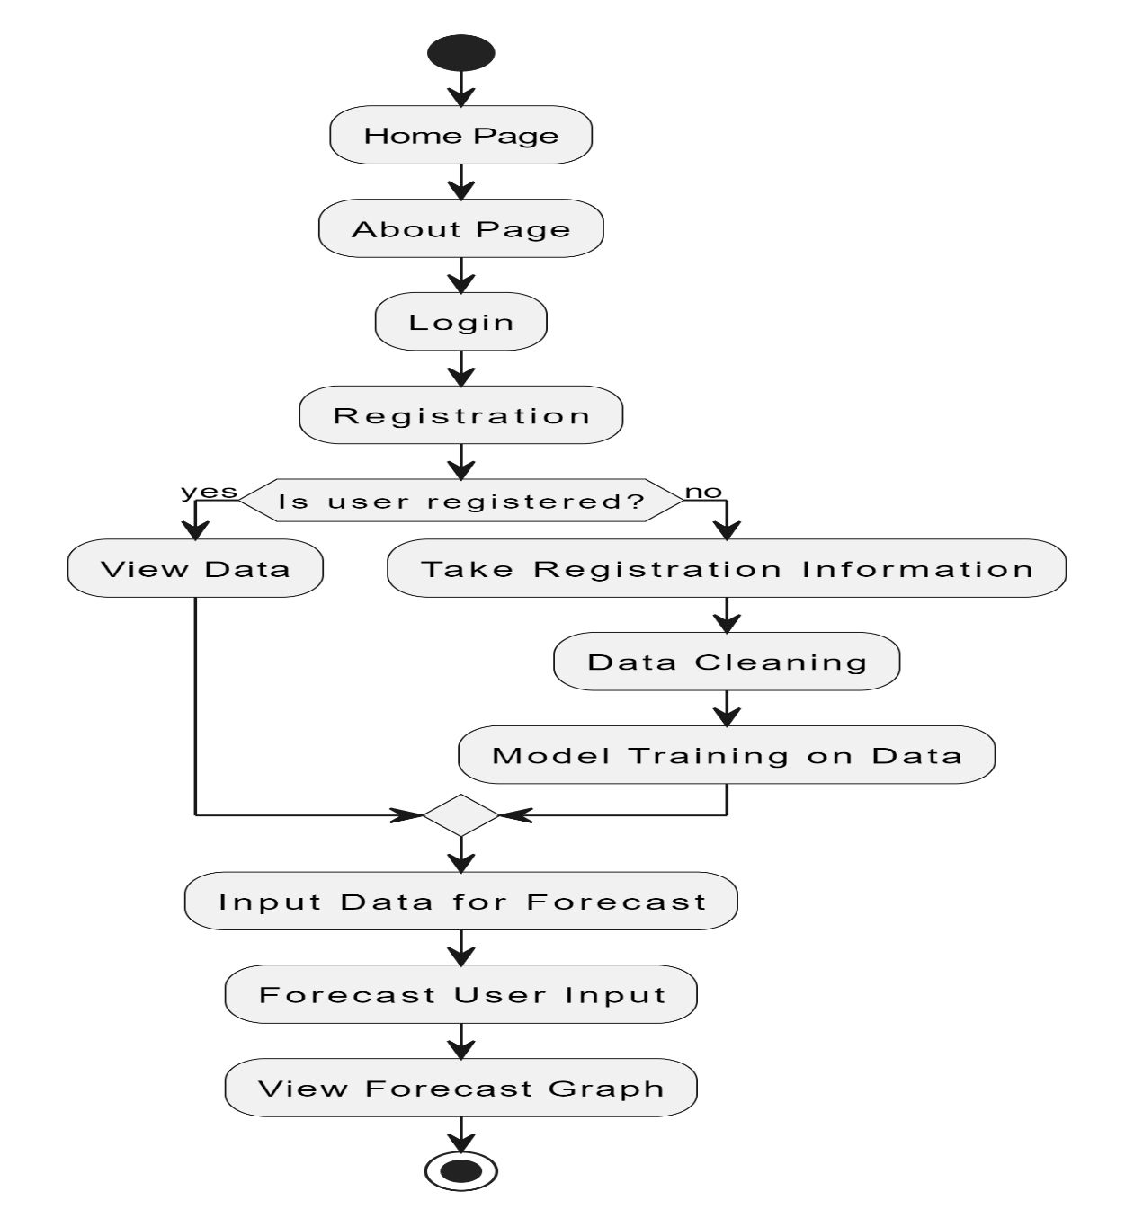
Activity Diagram:
Activity diagrams are graphical representations of workflows of stepwise activities and actions with support for choice, iteration and concurrency. In the Unified Modelling Language, activity diagrams can be used to describe the business and operational step-by-step workflows of components in a system. An activity diagram shows the overall flow of control.
Figure: Activity diagram

Slide 21
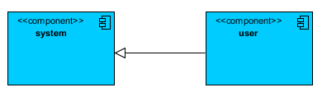
Component Diagram:
A component diagram, also known as a UML component diagram, describes the organization and wiring of the physical components in a system. Component diagrams are often drawn to help model implementation details and double-check that every aspect of the system's required function is covered by planned development.
Figure: Component diagram

Slide 22
UML DIAGRAMS
ER Diagram:
An Entity–relationship model (ER model) describes the structure of a database with the help of a diagram, which is known as Entity Relationship Diagram (ER Diagram). An ER model is a design or blueprint of a database that can later be implemented as a database. The main components of E-R model are: entity set and relationship set.
An ER diagram shows the relationship among entity sets. An entity set is a group of similar entities and these entities can have attributes. In terms of DBMS, an entity is a table or attribute of a table in database, so by showing relationship among tables and their attributes, ER diagram shows the complete logical structure of a database. Let’s have a look at a simple ER diagram to understand this concept.

Slide 23
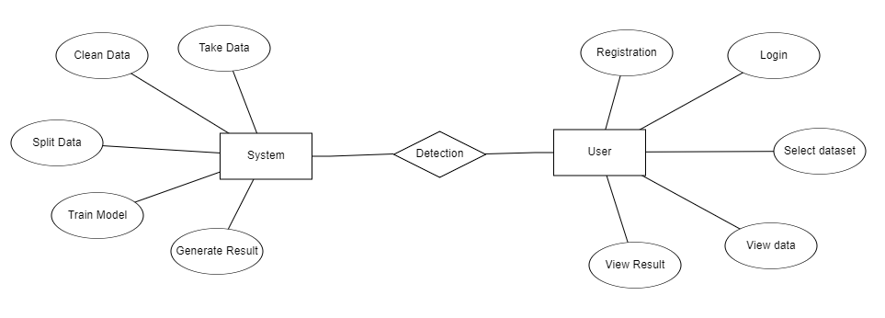
Figure: ER diagram

Slide 24
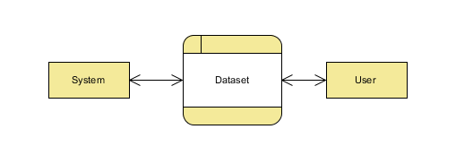
DFD Diagram:
A Data Flow Diagram (DFD) is a traditional way to visualize the information flows within a system. A neat and clear DFD can depict a good amount of the system requirements graphically. It can be manual, automated, or a combination of both. It shows how information enters and leaves the system, what changes the information and where information is stored. The purpose of a DFD is to show the scope and boundaries of a system as a whole. It may be used as a communications tool between a systems analyst and any person who plays a part in the system that acts as the starting point for redesigning a system.
Figure: Context Level diagram

Slide 25
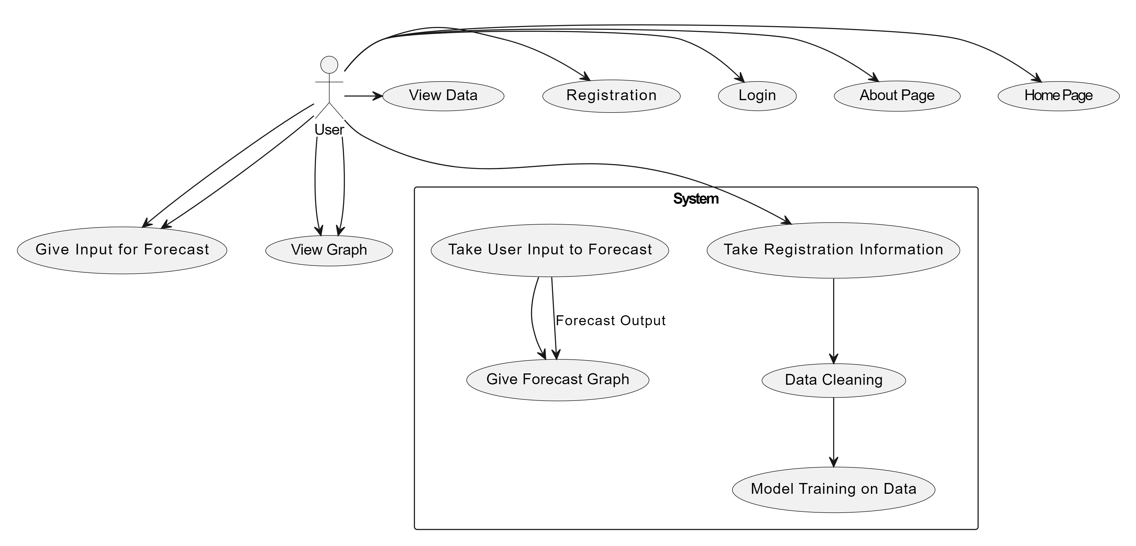
FigureLevel-1 diagram

Slide 26
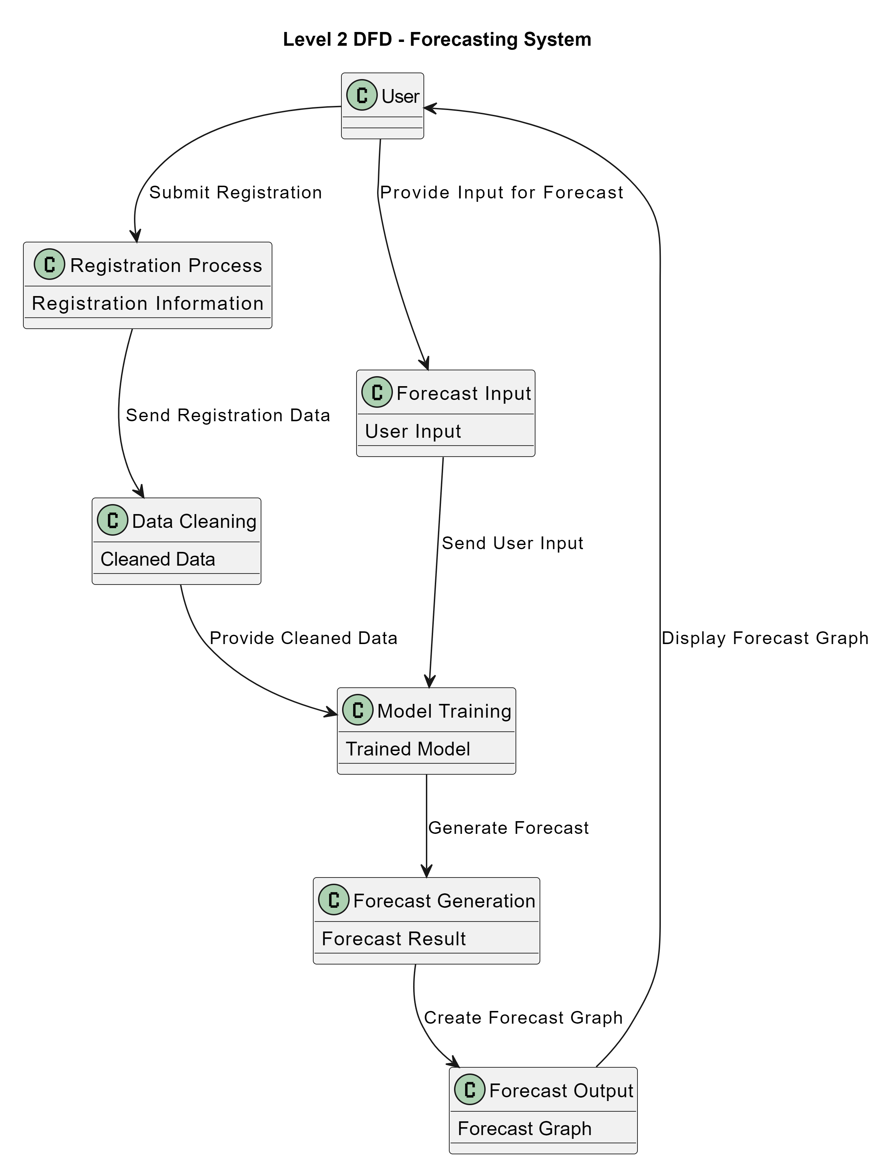
Figure:Level-2 diagram

Slide 27
Research Gap analysis
Model Comparisons: Limited studies systematically compare the performance of traditional statistical models (ARIMA) with advanced machine learning models (RNN, LSTM) and Prophet in Bitcoin price prediction.
Impact of Market Events: Few studies incorporate external market events or news sentiment analysis to evaluate their influence on Bitcoin price fluctuations and model performance.
Handling Volatility: There is a lack of comprehensive approaches that specifically address the volatility of cryptocurrency markets when developing predictive models.
Temporal Dynamics: Research often overlooks the exploration of time-varying patterns and trends within Bitcoin price movements, which can enhance predictive accuracy.

Slide 28
Implementation
Data Analysis
Model Implementation
01
Data Description
04
Algorithm Definition
02
EDA Explanation
05
Working Process
03
Preprocessing steps
06
Results from Algorithm

Slide 29
Data Description
Dataset: https://www.kaggle.com/datasets/jkraak/bitcoin-price-dataset
The dataset utilized in this study comprises historical Bitcoin trading data, specifically focusing on timestamps and closing prices. Each entry records critical metrics, including the opening, high, low, and closing prices, along with trading volume, quote asset volume, and the number of trades conducted. The data spans multiple time intervals, providing a comprehensive view of market fluctuations. This extensive dataset serves as the foundation for training and evaluating various predictive models, including RNN, LSTM, ARIMA, and Facebook's Prophet, allowing for an in-depth analysis of Bitcoin price trends and volatility within the cryptocurrency market.

Slide 30
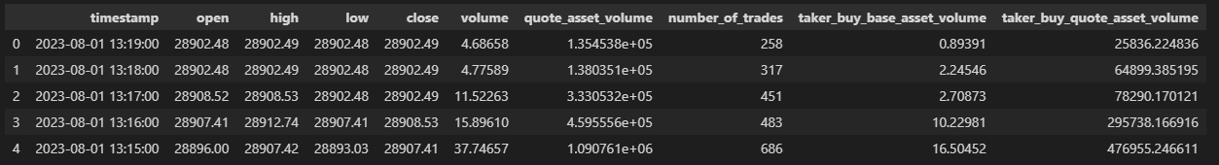
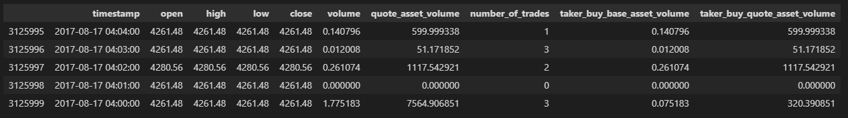
Exploratory Data Analysis
This the top 5 rows of the dataset here we see the how was the dataset values.
This the Bottom 5 rows of the dataset here we see the how was the dataset values.

Slide 31
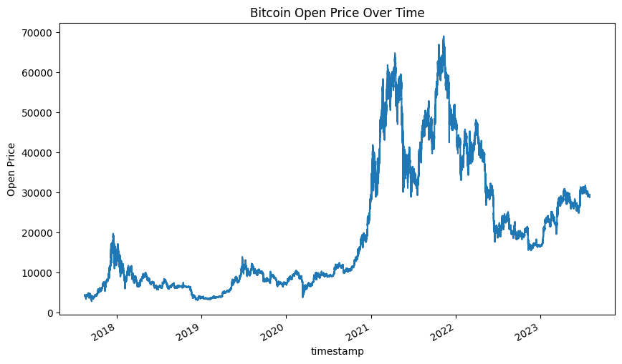
Line Plot

Slide 32

Line Plot

Slide 33
Pre-processing steps
To prepare the dataset for time series analysis, we first convert the 'timestamp' column into a datetime format, enabling accurate time-based operations. Next, we check for and handle any null values to ensure data integrity, which may involve imputing missing values or removing affected rows. Subsequently, we split the dataset into training and testing subsets, typically allocating 70-80% of the data for training and the remainder for testing. This process ensures that the models are trained on historical data while retaining a separate set for evaluating their predictive performance.

Slide 34
Algorithm Definition
Recurrent Neural Networks (RNNs):
Recurrent Neural Networks (RNNs) are a powerful class of neural networks designed for sequential data, making them suitable for time series analysis, including Bitcoin price prediction. Unlike traditional feedforward networks, RNNs have connections that loop back on themselves, allowing them to maintain a memory of previous inputs. This feature enables RNNs to capture temporal dependencies in the data, which is crucial for predicting future price movements based on historical trends.
In the context of Bitcoin price prediction, RNNs can learn complex patterns from historical price data, trading volumes, and other relevant features. By processing the data sequentially, RNNs can adjust their predictions based on the sequence of past values, providing more accurate forecasts. Variants of RNNs, such as Long Short-Term Memory (LSTM) networks, enhance this capability by mitigating issues like vanishing gradients, enabling the model to retain information over longer periods. Overall, RNNs offer a promising approach for analysing and predicting Bitcoin prices effectively.

Slide 35
LSTM
Long Short-Term Memory (LSTM) networks are a specialized type of recurrent neural network (RNN) designed to capture temporal dependencies in sequential data. In the context of Bitcoin price prediction, LSTM models excel due to their ability to retain information over extended periods, effectively handling the intricacies of price movements influenced by various factors. The architecture includes memory cells that allow the network to learn from historical data while mitigating the vanishing gradient problem commonly encountered in traditional RNNs. By training on past Bitcoin prices and relevant market indicators, LSTM can discern patterns and trends, enabling more accurate forecasts. The model's capacity to adapt to non-linear relationships makes it particularly suitable for financial time series, where price dynamics can be erratic. Evaluating the performance of LSTM against other forecasting models can provide insights into its effectiveness in predicting Bitcoin prices, contributing to enhanced investment strategies and decision-making in the cryptocurrency market.

Slide 36
ARIMA:
ARIMA (Auto Regressive Integrated Moving Average) is a widely used statistical method for time series forecasting, particularly effective for analyzing and predicting Bitcoin prices. The ARIMA model combines three components: auto regression (AR), differencing (I), and moving average (MA). The autoregressive part captures the relationship between an observation and a number of lagged observations, while the moving average component accounts for the dependency between an observation and a residual error from a moving average model applied to lagged observations. Differencing is used to make the time series stationary, ensuring constant mean and variance over time. This method is advantageous for Bitcoin price prediction due to its ability to model trends and seasonality in volatile financial markets. By optimizing the model parameters (p, d, q), analysts can create robust forecasts, making ARIMA a valuable tool for investors and researchers aiming to understand Bitcoin price dynamics and trends.

Slide 37
Prophet:
Prophet is an open-source forecasting tool developed by Facebook, designed to handle time series data that exhibits trends and seasonality. It is particularly effective for data with strong seasonal effects and several seasons of historical data, making it a suitable choice for predicting Bitcoin prices. Prophet utilizes an additive model, which means it decomposes the time series into three main components: trend, seasonality, and holidays. The trend component captures the overall direction of the data, while the seasonal component accounts for periodic fluctuations. One of the standout features of Prophet is its ability to accommodate missing data and outliers, which are common in financial time series. With a user-friendly interface and flexibility in handling various forecasting scenarios, Prophet allows analysts and researchers to generate reliable predictions for Bitcoin price movements, helping investors make informed decisions based on historical trends and patterns.

Slide 38

OUTPUT SCREEN SHOTS WITH DESCRIPTION.
Home Page: Welcome to Time Series Analysis For Bitcoin Price Prediction Using Prophet.

Slide 39
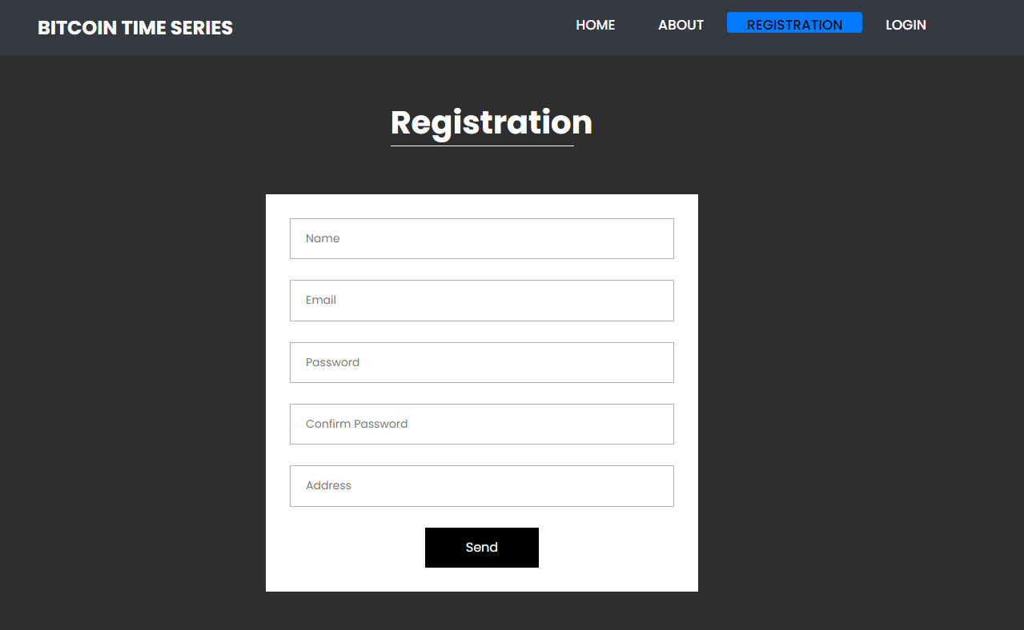
Registration: The registration page enables new users to create an account so user have to provide name, email, password, confirm password
and Address to register.

Slide 40
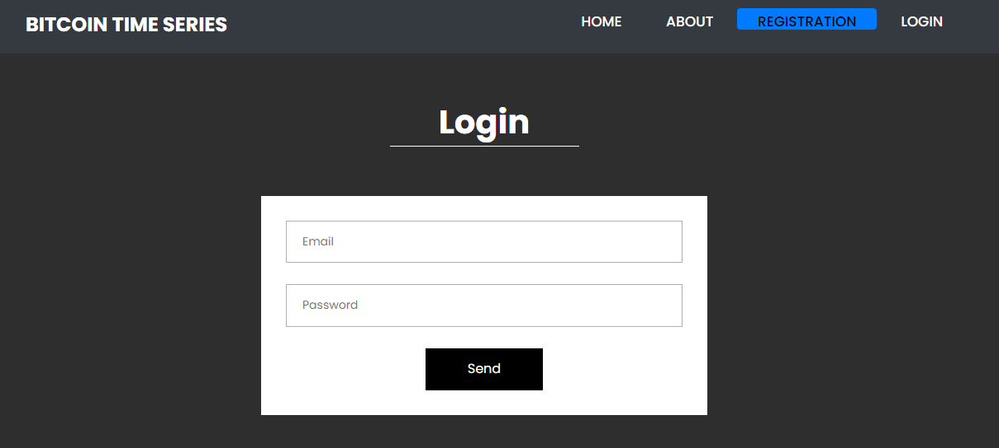
Login: The login page allows registered users to securely access the application. User have to provide register email and password.

Slide 41
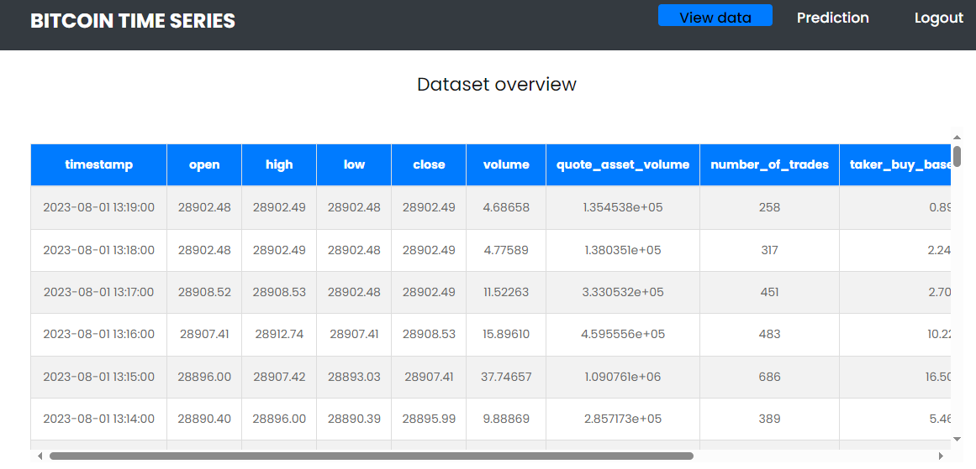
View: The view data page provides users with access to the data used for Time Series Analysis Bitcoin.

Slide 42
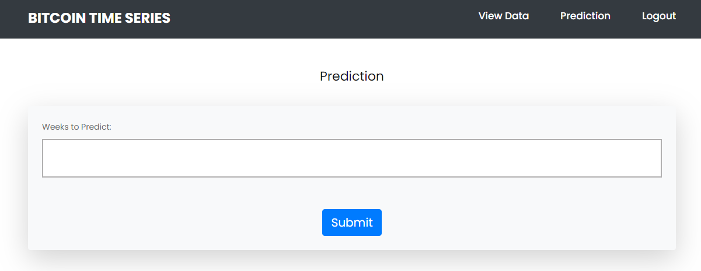
Prediction: This is the prediction page here user have to provide values in week to forecast the bitcoin value.

Slide 43
Future Scope
Integration of Additional Data Sources: Explore the incorporation of macroeconomic indicators and social media sentiment analysis to improve prediction accuracy in Bitcoin price forecasting.
Development of Hybrid Models: Investigate the potential of combining different predictive models, such as RNN and ARIMA, to leverage their strengths for enhanced forecasting performance.
Real-Time Prediction Systems: Design and implement a real-time Bitcoin price prediction system that utilizes machine learning models for dynamic trading strategies.
Application to Other Cryptocurrencies: Extend the analysis and methodologies developed in this study to other cryptocurrencies to evaluate their predictive efficacy across diverse digital assets.

Slide 44
Conclusion
In conclusion, this study demonstrates the effectiveness of various time series methodologies, including RNN, LSTM, ARIMA, and Facebook's Prophet, in predicting Bitcoin prices. By analysing historical price data, we identified that each model has distinct advantages and limitations, particularly in handling the volatility characteristic of cryptocurrency markets. Our findings suggest that while traditional models like ARIMA provide a solid baseline, advanced neural network approaches like LSTM and RNN may yield more accurate forecasts in certain scenarios. Facebook's Prophet also proved to be a valuable tool for capturing seasonality and trends. Ultimately, this research not only contributes to understanding Bitcoin price movements but also offers insights that can aid investors in making informed trading decisions amidst market fluctuations.

Slide 45
Reference
[1] I. Alqassem, I. Rahwan, and D. Svetinovic, “The anti-social system properties: Bitcoin network data analysis,” IEEE Trans. Syst., Man, Cybern., Syst., vol. 50, no. 1, pp. 21–31, Jan. 2020. [11] J. Kim, J. Kim, H. Kim, M. Shim, and E. Choi, ‘‘CNN-based network intrusion detection against denial-of-service attacks,’’ Electronics, vol. 9, no. 6, p. 916, Jun. 2020.
[2] P. Nerurkar, D. Patel, Y. Busnel, R. Ludinard, S. Kumari, and M. K. Khan, “Dissecting Bitcoin blockchain: Empirical analysis of Bit- coin network (2009–2020),” J. Netw. Comput. Appl., vol. 177, Mar. 2021, Art. no. 102940.
[3] M. K. Popuri and M. H. Gunes, Empirical Analysis of Crypto Curren- cies. Berlin, Germany: Springer, 2016, pp. 281–292.
[4] D. Ron and A. Shamir, “Quantitative analysis of the full Bitcoin transaction graph,” in Proc. Int. Conf. Financial Cryptography Data Secur. Cham, Switzerland: Springer, 2013, pp. 6–24.

Slide 46
[5] L. Serena, S. Ferretti, and G. D’Angelo, “Cryptocurrencies activity as a complex network: Analysis of transactions graphs,” Peer-Peer Netw. Appl., vol. 15, no. 2, pp. 839–853, Mar. 2022.
[6] B. Tao, I. W. Ho, and H.-N. Dai, “Complex network analysis of the Bitcoin blockchain network,” in Proc. IEEE Int. Symp. Circuits Syst. (ISCAS), May 2021, pp. 1–5.
[7] B. Tao, H.-N. Dai, J. Wu, I. W. Ho, Z. Zheng, and C. F. Cheang, “Complex network analysis of the Bitcoin transaction network,” IEEE Trans. Circuits Syst. II, Exp. Briefs, vol. 69, no. 3, pp. 1009–1013, Mar. 2022.
[8] S. Ranshous et al., “Exchange pattern mining in the Bitcoin transaction directed hypergraph,” in Financial Cryptography and Data Security. Sliema, Malta: Springer, 2017, pp. 248–263.
[9] M. Romiti, A. Judmayer, A. Zamyatin, and B. Haslhofer, “A deep dive into Bitcoin mining pools: An empirical analysis of mining shares,” 2019, arXiv:1905.05999.
[10] N. Tovanich, N. Soulié, N. Heulot, and P. Isenberg, “An empirical analysis of pool hopping behavior in the Bitcoin blockchain,” in Proc. IEEE Int. Conf. Blockchain Cryptocurrency, May 2021, pp. 1–9.

Slide 47
THANK YOU

